Slide 1
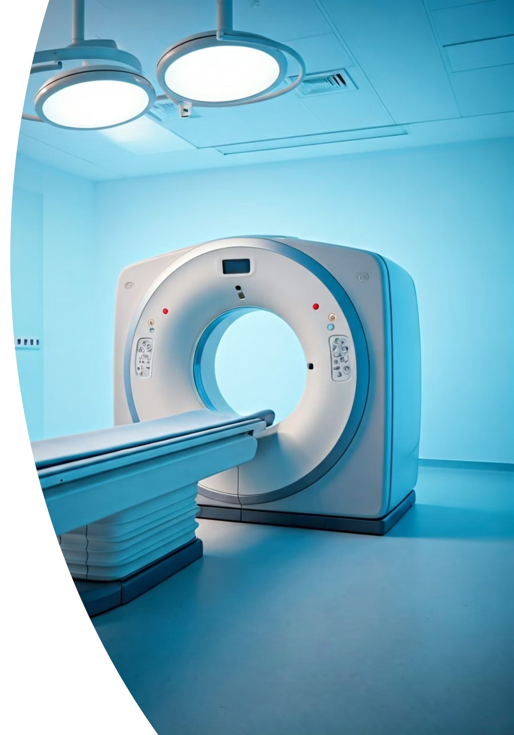

CT Scan – Explained for Beginners
What is a CT Scan?
A CT Scan (also called CAT Scan) is a test that uses X-rays and a computer to take clear pictures of the inside of your body. It gives more detailed images than a regular X-ray.
by Ram N Java

Slide 2

Why is a CT Scan done?
Find the cause of pain, swelling, or injury
Check for infections, tumors, or bleeding
Look at organs like the lungs, liver, kidneys, and brain
Guide surgeries or treatments

Slide 3
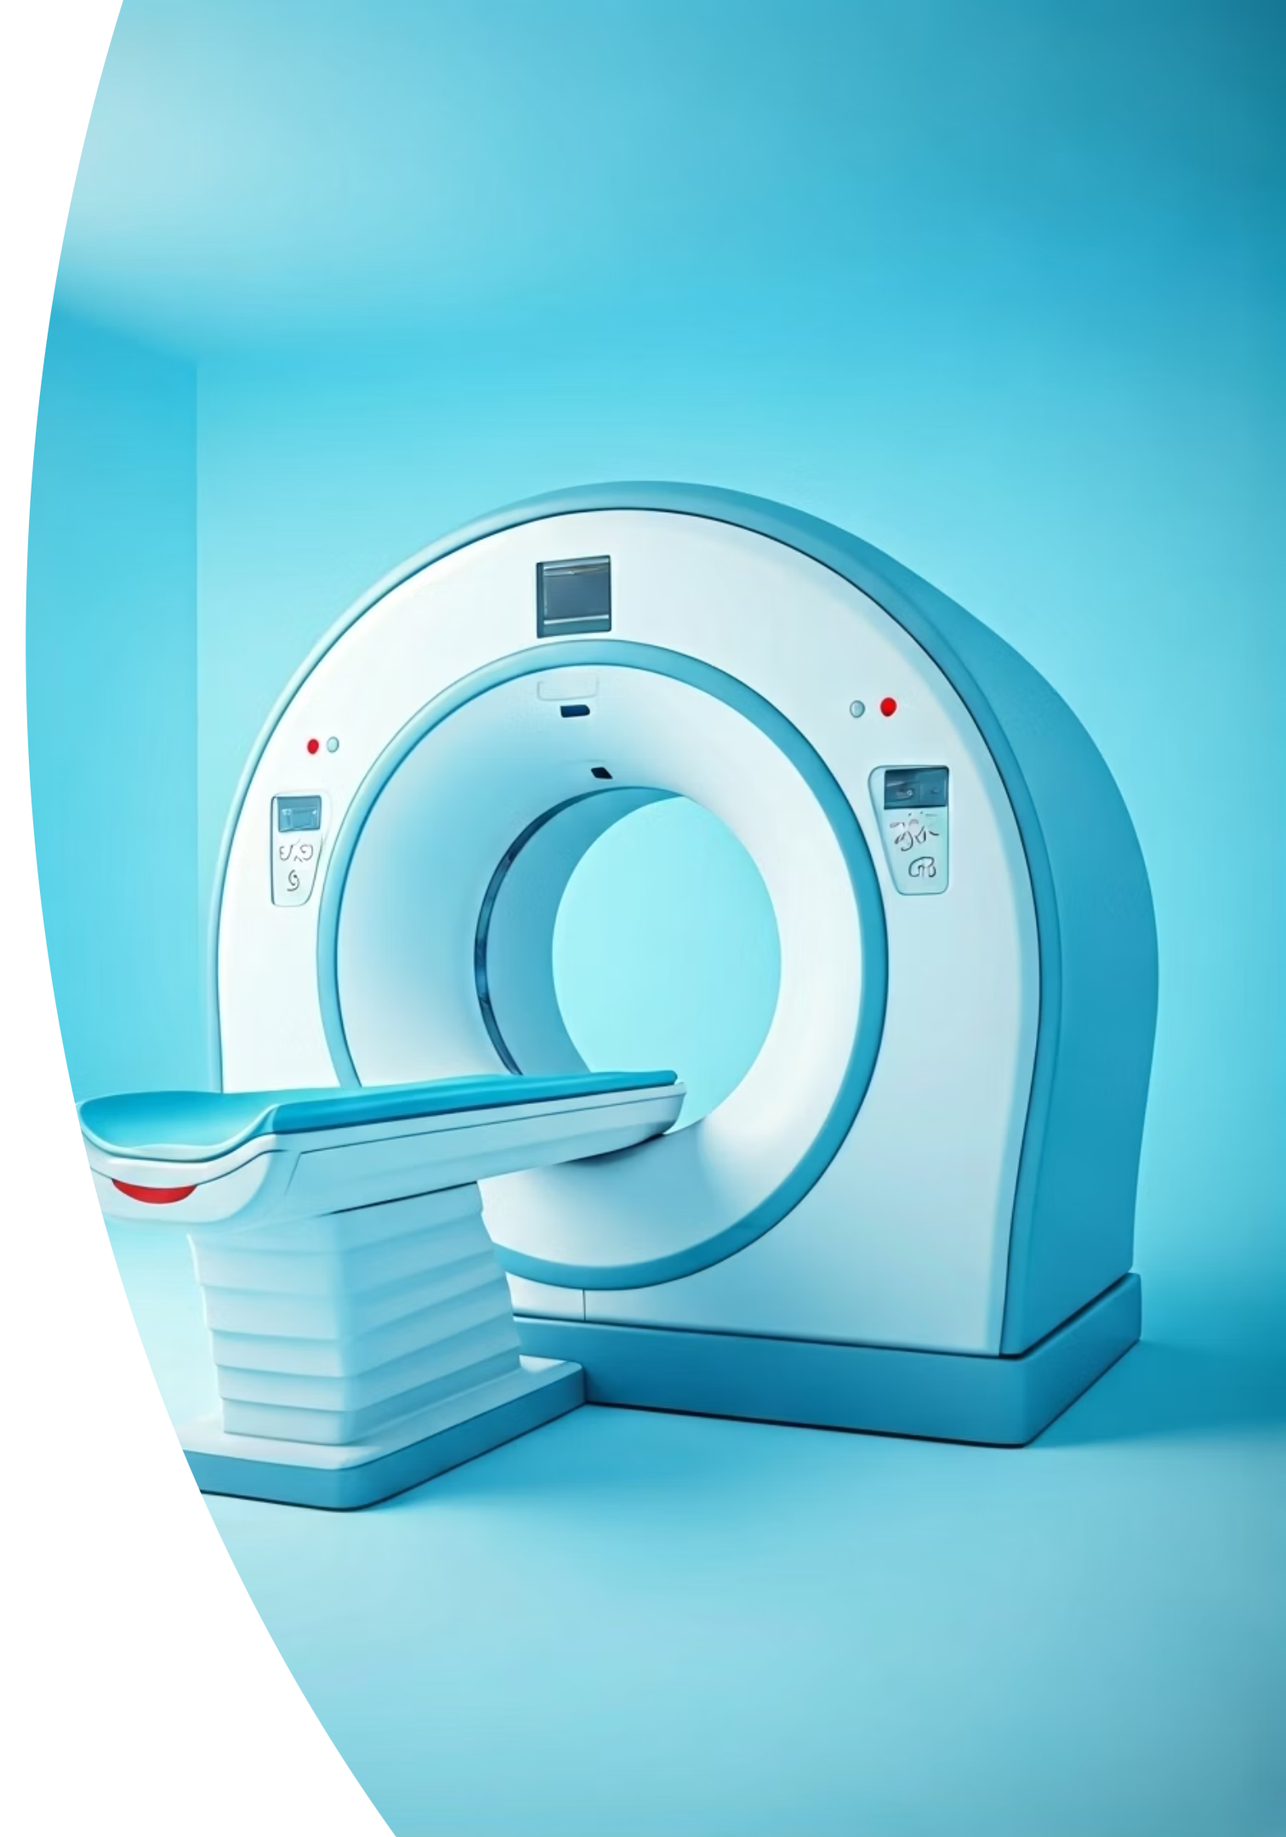
How does a CT Scan work?
Step 1
You lie on a bed that slides into a large ring-shaped machine.
Step 2
The machine rotates and takes many X-ray pictures from different angles.
Step 3
A computer combines the images to create detailed 3D pictures of your body.

Slide 4

What happens during the scan?
Is it painful?
No, the scan does not hurt.
You may feel a small pinch if a dye injection is given.
Duration
1
The scan usually takes 10 to 15 minutes.
2
Position
You must lie very still so the pictures are clear.
Breathing
3
You may be asked to hold your breath for a few seconds.
4
Contrast
Sometimes, a contrast dye is given by injection or by mouth to highlight certain areas.

Slide 5




Is it safe?
Yes, it is safe when done properly.
CT scans use a small amount of radiation, but doctors only use it when necessary.
Important to tell your doctor if you:
Pregnancy
Are pregnant
Kidney Issues
Have kidney problems (before taking contrast dye)
Allergies
Have allergies (to medicines or dyes)

Slide 6
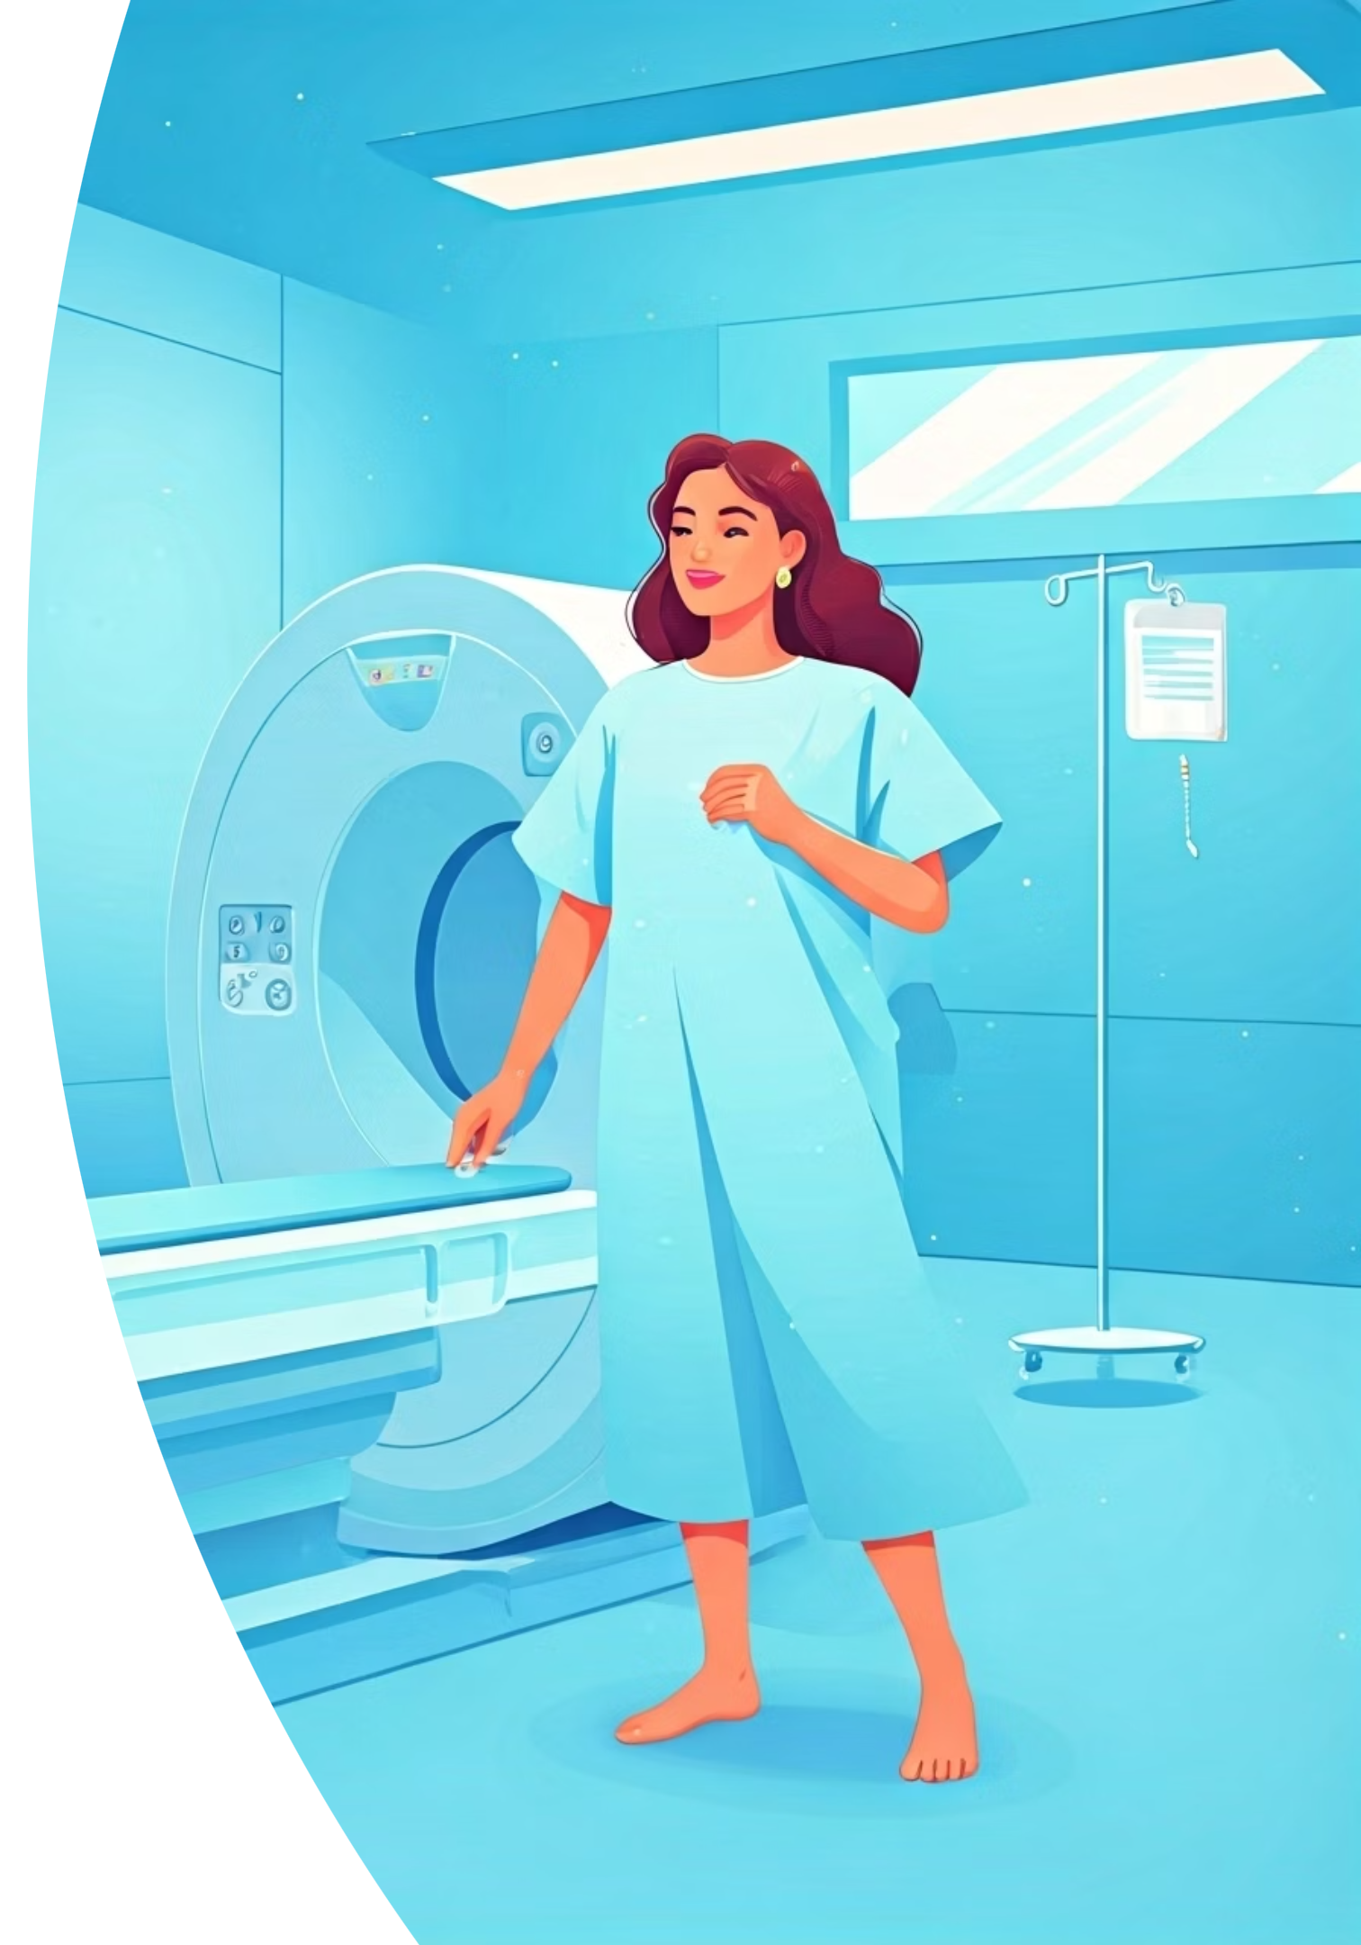
How to prepare for a CT Scan?
Wear loose, comfortable clothes or a hospital gown.
Remove metal items like jewelry or glasses.
Follow any fasting instructions if told to (like not eating for a few hours).
Tell the doctor about your medical history or medicines you take.

Slide 7

What happens after the scan?
After your CT scan:
You can usually go home right away.
The doctor will check the images and explain the results to you.

